Slide 1
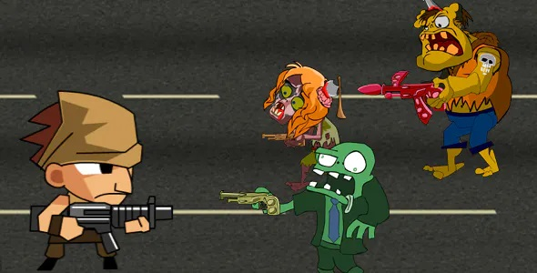
Group assignment
Visual programming

Slide 2

Introduction of the Windows Application
Our project is on a Shooting Game app.
We managed to finished it with quality and efficiency.
Also this doesn’t required fluency in English, so that almost everyone can use without any age or language barrier.

Slide 3
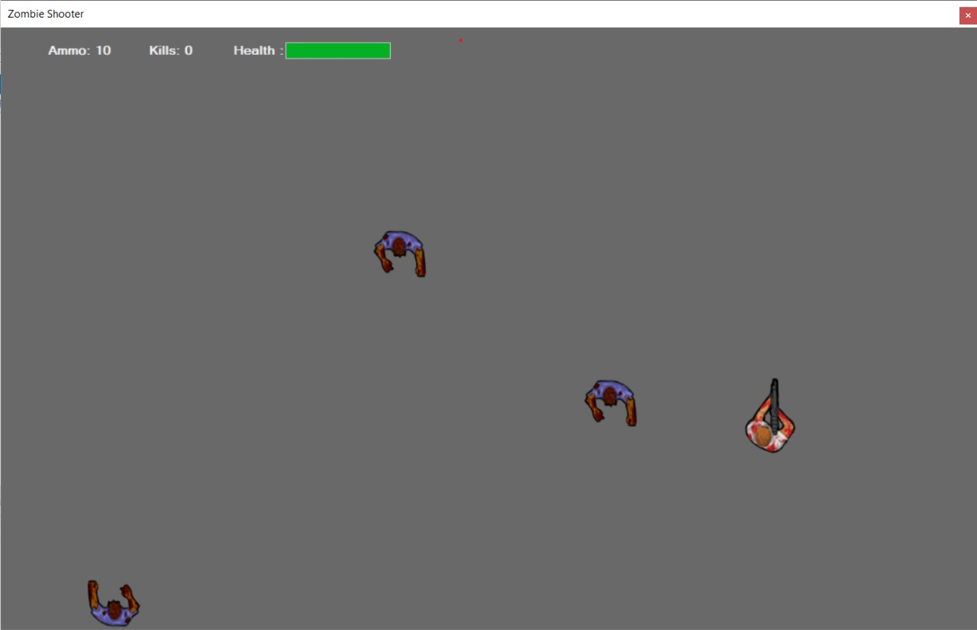

Slide 4
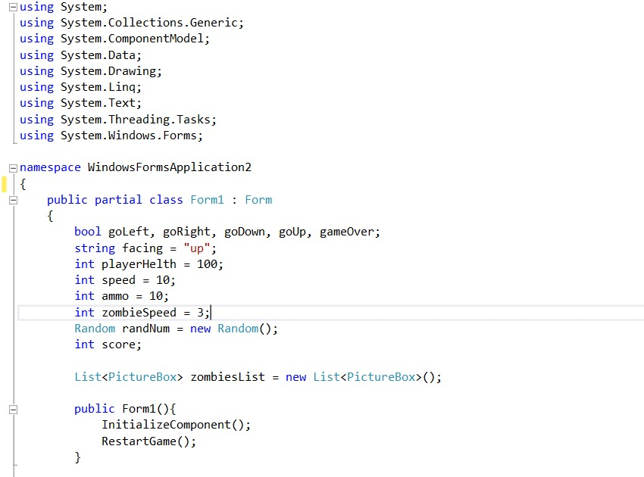
Main Timer Event

Slide 5
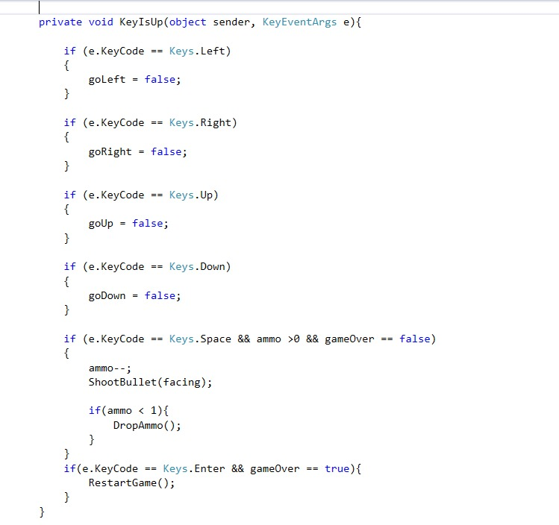
Keys Up

Slide 6
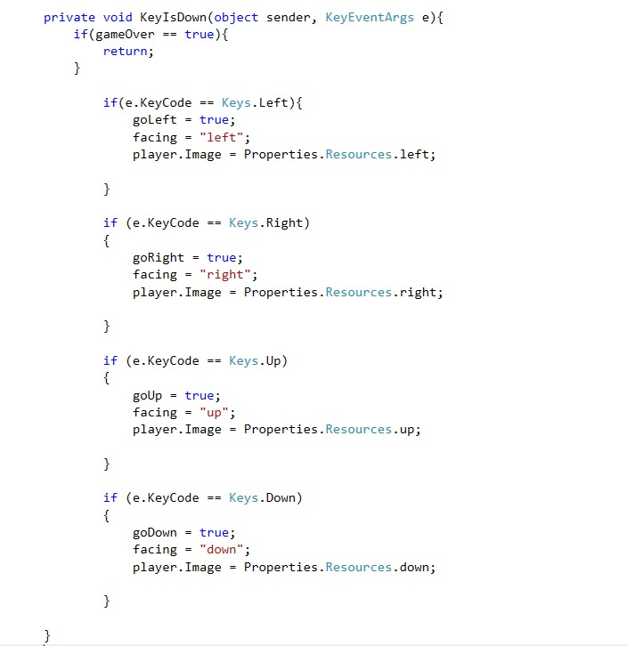
Keys Down

Slide 7
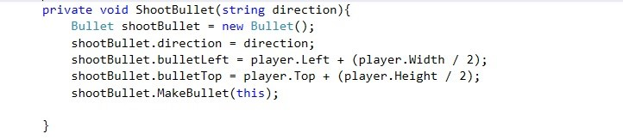
Shoot bullet

Slide 8
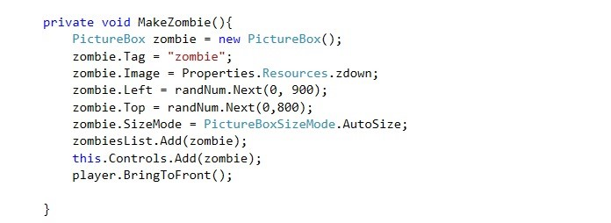
Make Zombie

Slide 9
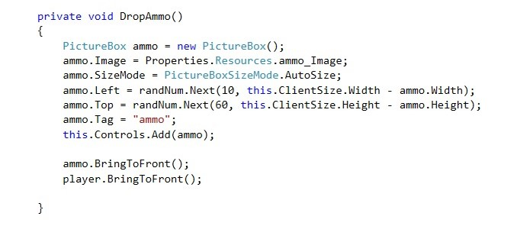
Drop Ammo

Slide 10
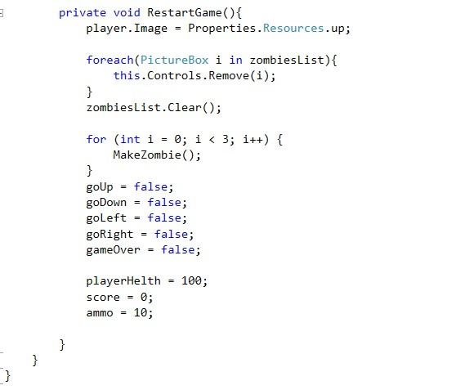
Restart Game

Slide 11

Group Members
KTC Maduwantha(SOF/19/B1/25)
NBRA Apeksha(SOF/19/B1/11)
WKC de Silva(MMW/19/B1/39)
Dinithi
Madush
R.D.S.C.Karunarathna(MMW/19/B1/37)

Slide 12

Questions & Thank You!

